Slide 1






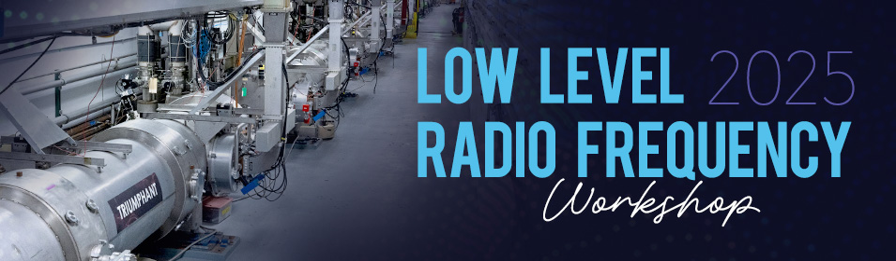
PIP-II is a partnership of:
US-DOE
India-DAE
Italy-INFN
UK-STFC-UKRI
France-CEA, CNRS/IN2P3
Poland-WUST, WUT, TUL
LLRF System Analysis for the
Fermilab PIP-II LINAC
P. Varghese, M. Guran, L. Reyes, S. Raman, FNAL
14 October 2025

Slide 2


Outline
PIP2-LINAC Accelerator Components
LLRF System – SEL Architecture
3. Calibrations and SEL Operational Modes
Physics Requirements – LLRF Specifications
Analysis of Feedback Loops and Stability
Beam Loading in PIP-II cavities
7. Steps towards improving performance

Slide 3
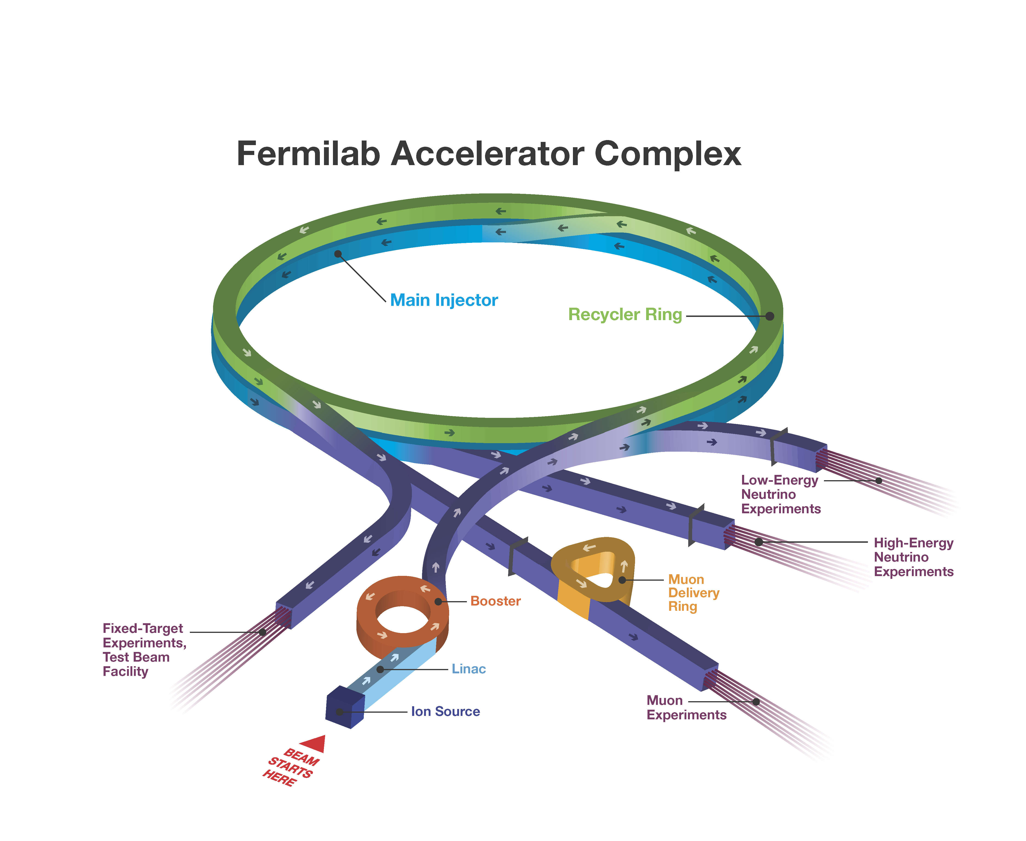
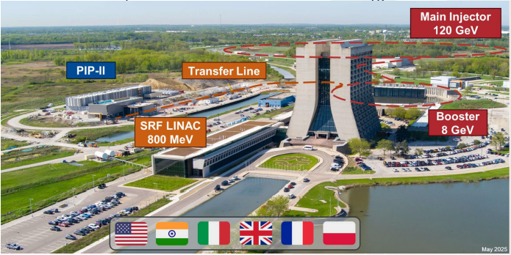
Fermilab Accelerator Complex

Slide 4
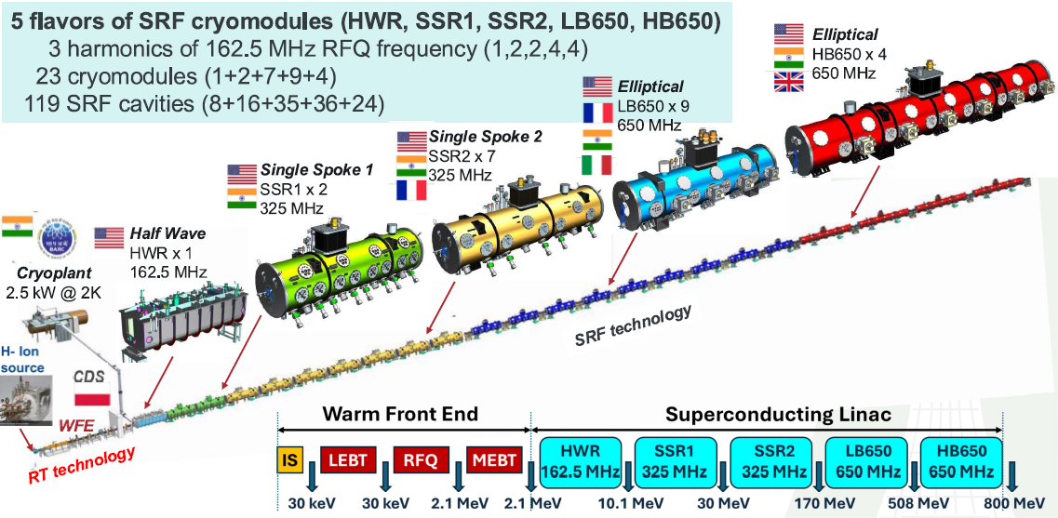
Fermilab Accelerator Complex

Slide 5
PIP2 4-Cavity RF Station

Slide 6
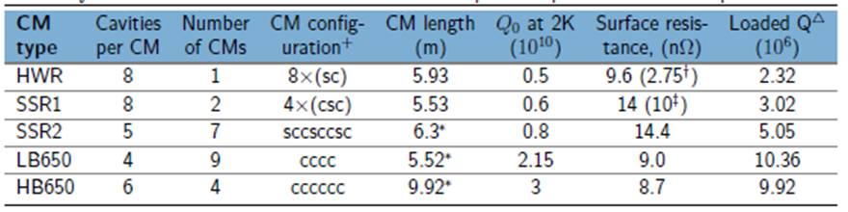
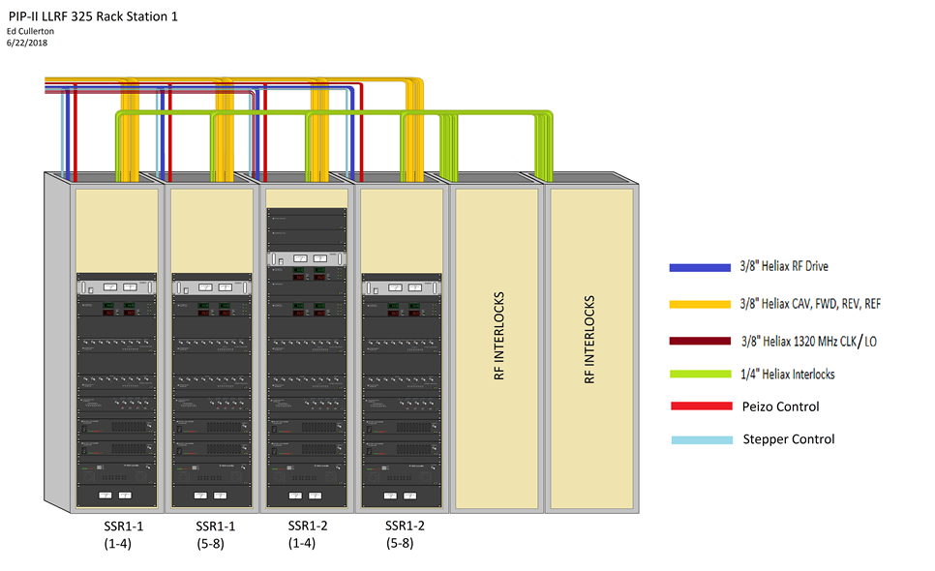
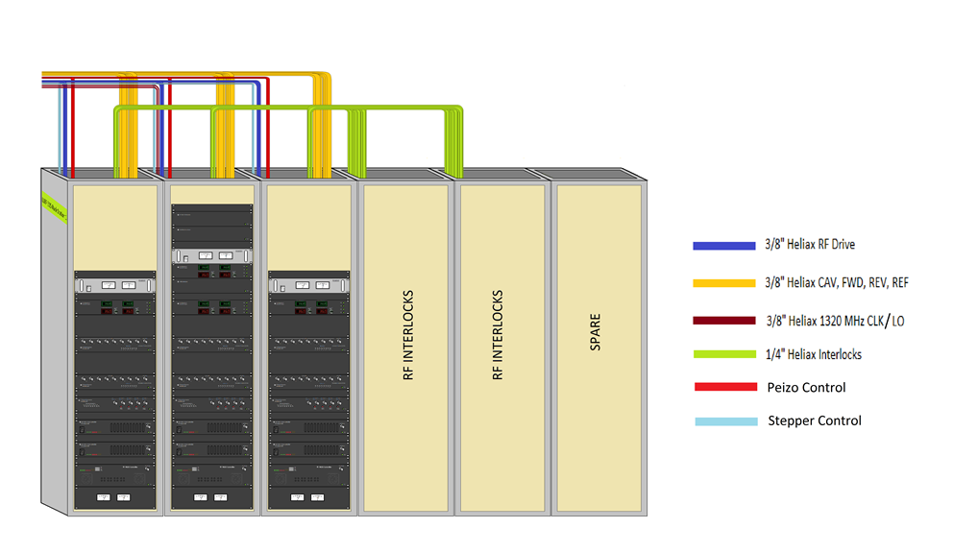
PIP2 LLRF Systems
 | Station1 | Station2 | Station3 | Station4 | Station 5 | Station6 | Station7 | Station8 | Station9 | Station10 | Station11 | Total
 | RFQ, B1-4 | HWR | SSR1-1,2 | SSR2-1,2,3 | SSR2-4,5 | SSR2-6,7 | LB650-1,2,3 | LB650-4,5,6 | LB650-7,8,9 | HB650-1,2 | HB650-3,4
Number of cavities | 6 | 8 | 16 | 15 | 10 | 10 | 12 | 12 | 12 | 12 | 12 | 125
RF Freq (MHz) | 162.5 | 162.5 | 325 | 325 | 325 | 325 | 650 | 650 | 650 | 650 | 650
S3 – SSR1-1,SSR1-2
S4-S11 – SSR2 (7),
LB650 (9), HB650 (4)

Slide 7
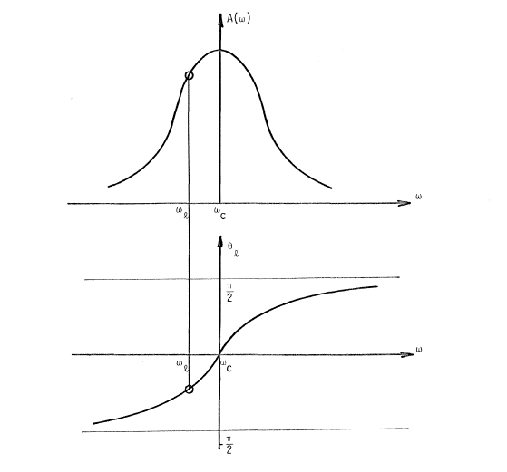
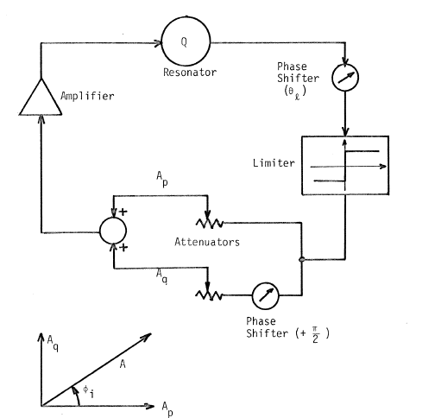
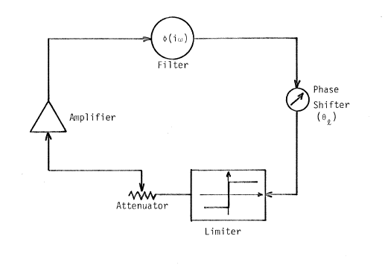
SEL Principle
Key Features
Positive feedback configuration requires limiters
Loop phase offset is 2nπ of oscillation frequency
Cavity stored energy and field magnitude depends on the real or inphase(I) component of forward power
Detuning due to microphonics and other disturbances are compensated by the quadrature(Q) component
In GDR mode (SELAP) both positive(low gain) and negative(high gain) feedback loops are active

Slide 8
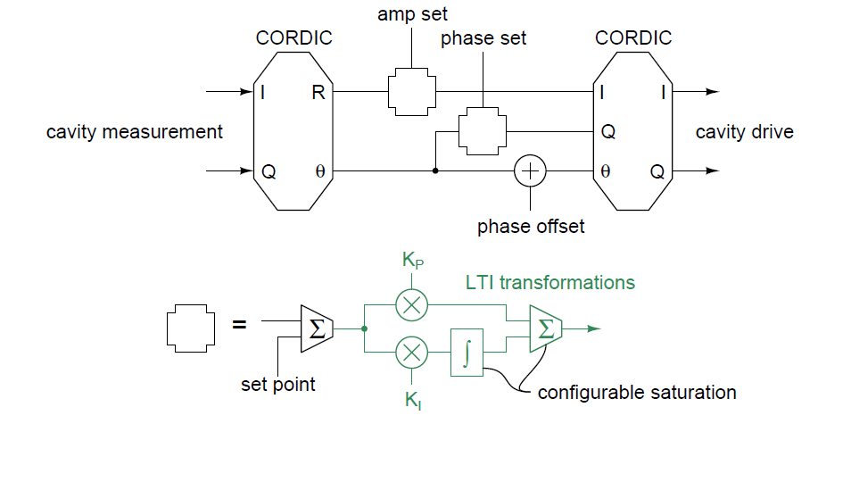
SEL System Architecture

Slide 9
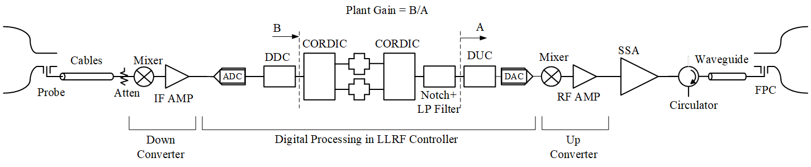
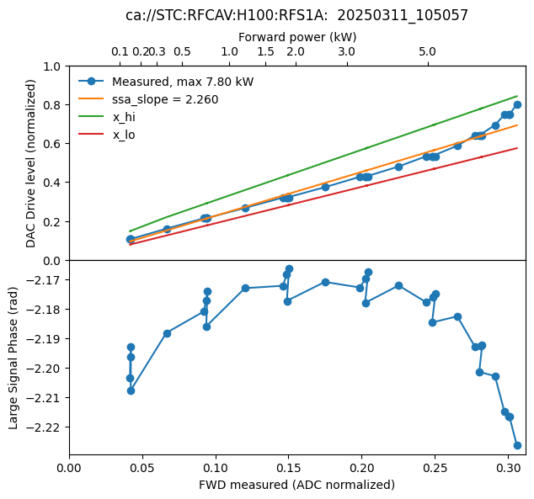
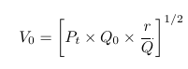
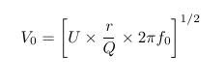
SEL System Calibrations
Transmitted Power
Stored Energy from Reverse
Power during cavity decay
SSA Calibration
Gradient Calibration

Slide 10
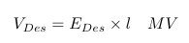
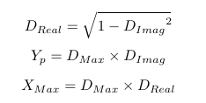
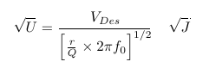
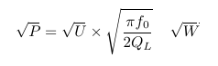
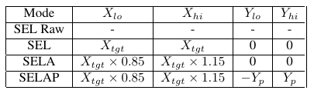
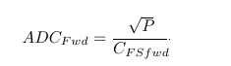
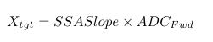
Computing SEL Mode Limits
Real Power
Imag Power

Slide 11
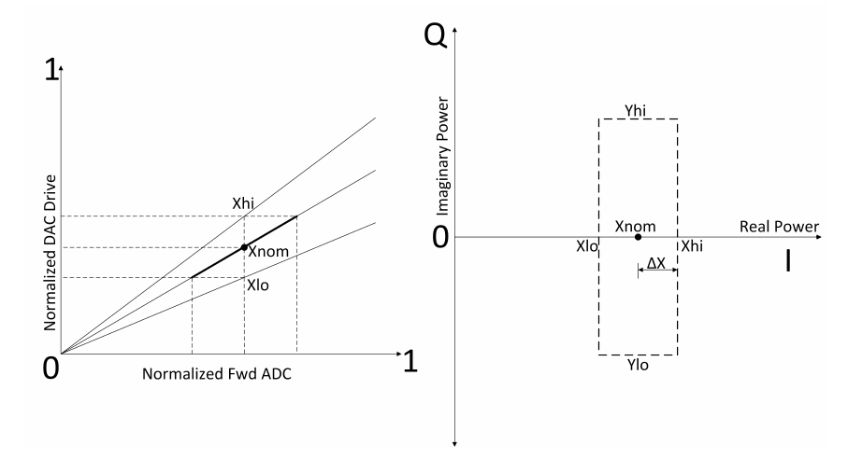
Computing SEL Mode Limits
SSA Calibration
Forward Power

Slide 12
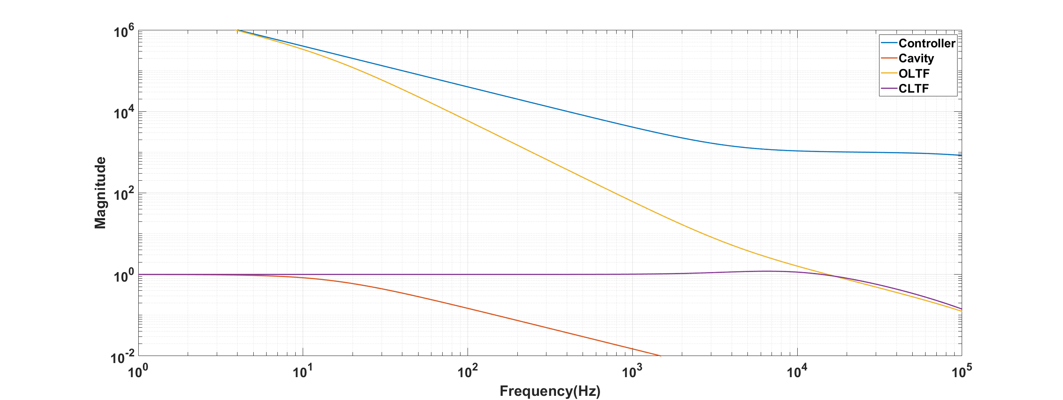
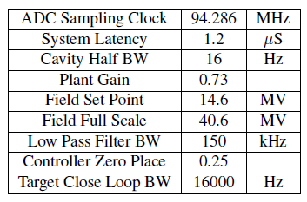
Gain Tuning Procedure LCLS-II
Increase system gain and check if SEL limits are exceeded
in the amplitude or phase feedback loops.
If one of the limits is crossed reduce closed loop bandwidth (system gain)
Till the outputs are within the SEL limits

Slide 13
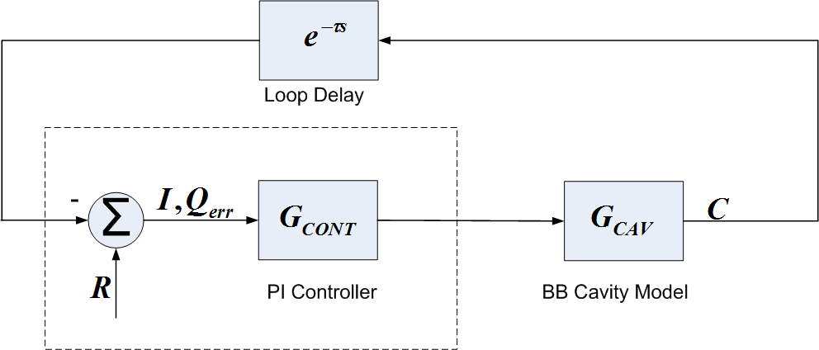
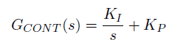
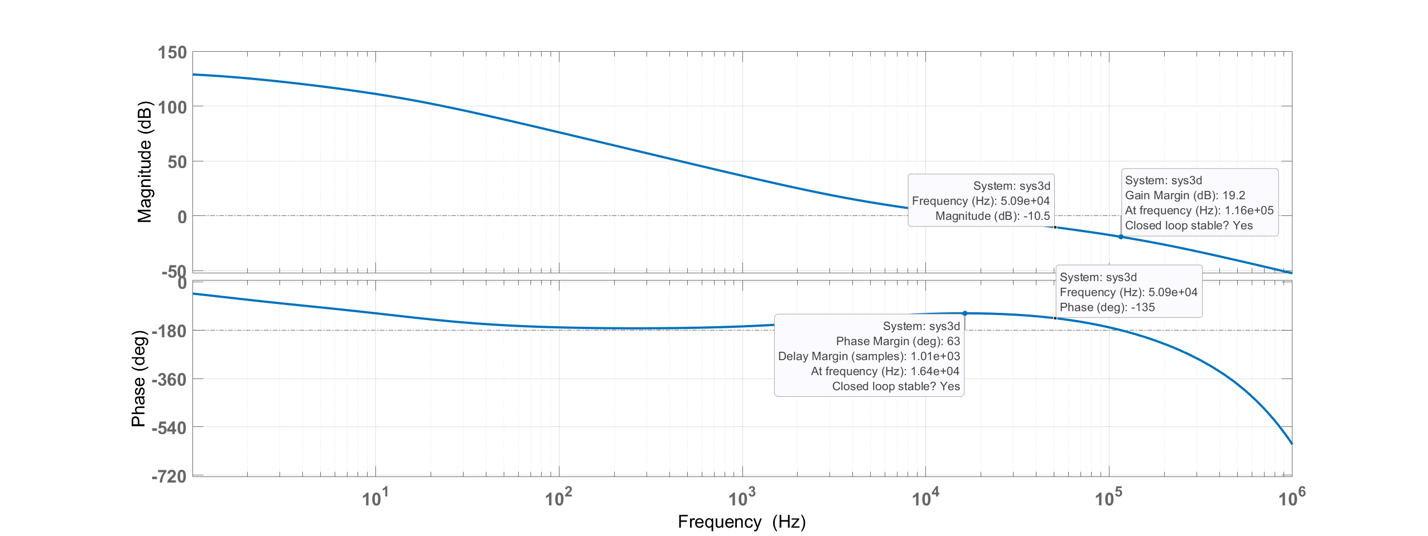
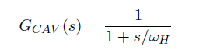
Stability Analysis with Bode Plot

Slide 14
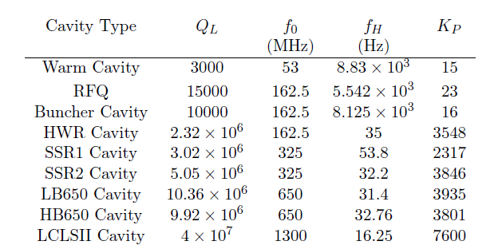
PIP-II Loop Delay Components
Delay | RFQ | Buncher | HWR | SSR1 | SSR2 | LB650 | HB650
Total | 985 | 1200 | 920 | 2720 | 2720 | 2770 | 2720
LLRF Controller Delay | 500 | 500 | 500 | 2100 | 2100 | 2100 | 2100
LLRF-Amplifier Drive (cable) | 50 | 150 | 20 | 70 | 70 | 70 | 70
Amplifier | 200 | 100 | 100 | 200 | 200 | 200 | 200
HPRF Distribution | 150 | 200 | 200 | 200 | 200 | 250 | 200
RF Fanback to LLRF (cable) | 85 | 250 | 100 | 150 | 150 | 150 | 150
Cavity half bandwidth (Hz) | 5542 | 8125 | 35 | 53.8 | 32.2 | 31.4 | 32.76
Gain (Max with 45 deg phase margin) | 23 | 16 | 3846 | 881 | 1462 | 1479 | 1430
Assumed loop delay = 1 us

Slide 15
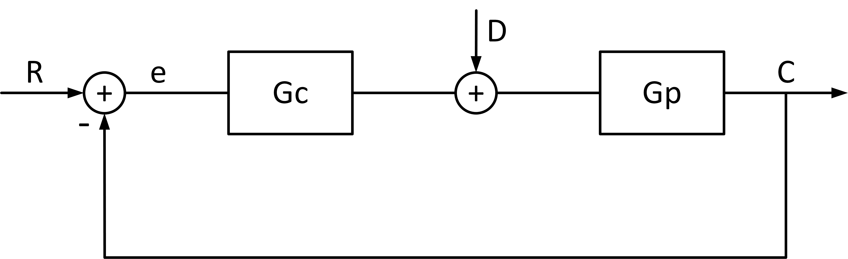
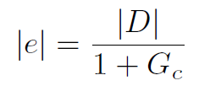
Disturbance Rejection and Regulation Requirements
PIP-II Specifications
Energy Stability(Linac) < 0.01%
Amplitude Regulation(individual cavity) < 0.06 rms %
Phase Regulation < 0.06 rms deg
Maximum detuning < 20 Hz

Slide 16
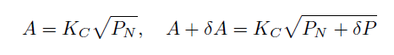
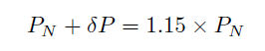
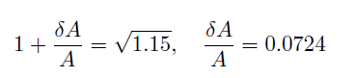
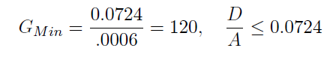
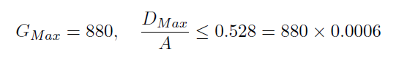
Disturbance Rejection and Regulation – Amplitude Loop
When above limits are used
Stability analysis gives a max gain for SSR1 cavities of 880
Provided the box limits are increased

Slide 17
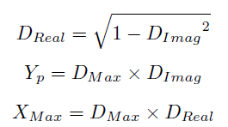
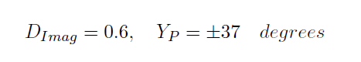
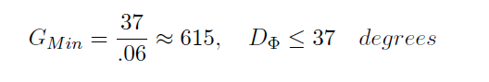
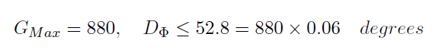
Disturbance Rejection and Regulation – Phase Loop
For example, if
Stability analysis gives a max gain for SSR1 cavities of 880
Provided the box limits are increased

Slide 18
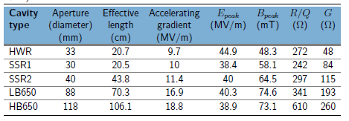
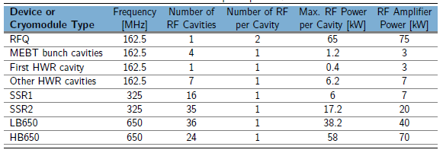
PIP-II Cavity/Amplifier Parameters

Slide 19
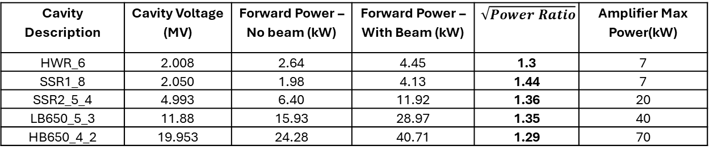
Beam Loading in PIP-II Cavities
PIP-II Beam Current = 2000 μA
LCLS-II Beam Current = 100 μA /300 μA
JLAB Beam Current = 400 μA
Cavity Description | Cavity Voltage (MV) | Forward Power – No beam (kW) | Forward Power – With Beam (kW) | $$\sqrt{Power Ratio}$$ | Amplifier Max Power(kW)
HWR_6 | 2.008 | 2.64 | 4.45 | 1.3 | 7
SSR1_8 | 2.050 | 1.98 | 4.13 | 1.44 | 7
SSR2_5_4 | 4.993 | 6.40 | 11.92 | 1.36 | 20
LB650_5_3 | 11.88 | 15.93 | 28.97 | 1.35 | 40
HB650_4_2 | 19.953 | 24.28 | 40.71 | 1.29 | 70
Feedback limits currently allow for 1.15 increase in power ratio
Feedforward beam loading compensation is needed

Slide 20
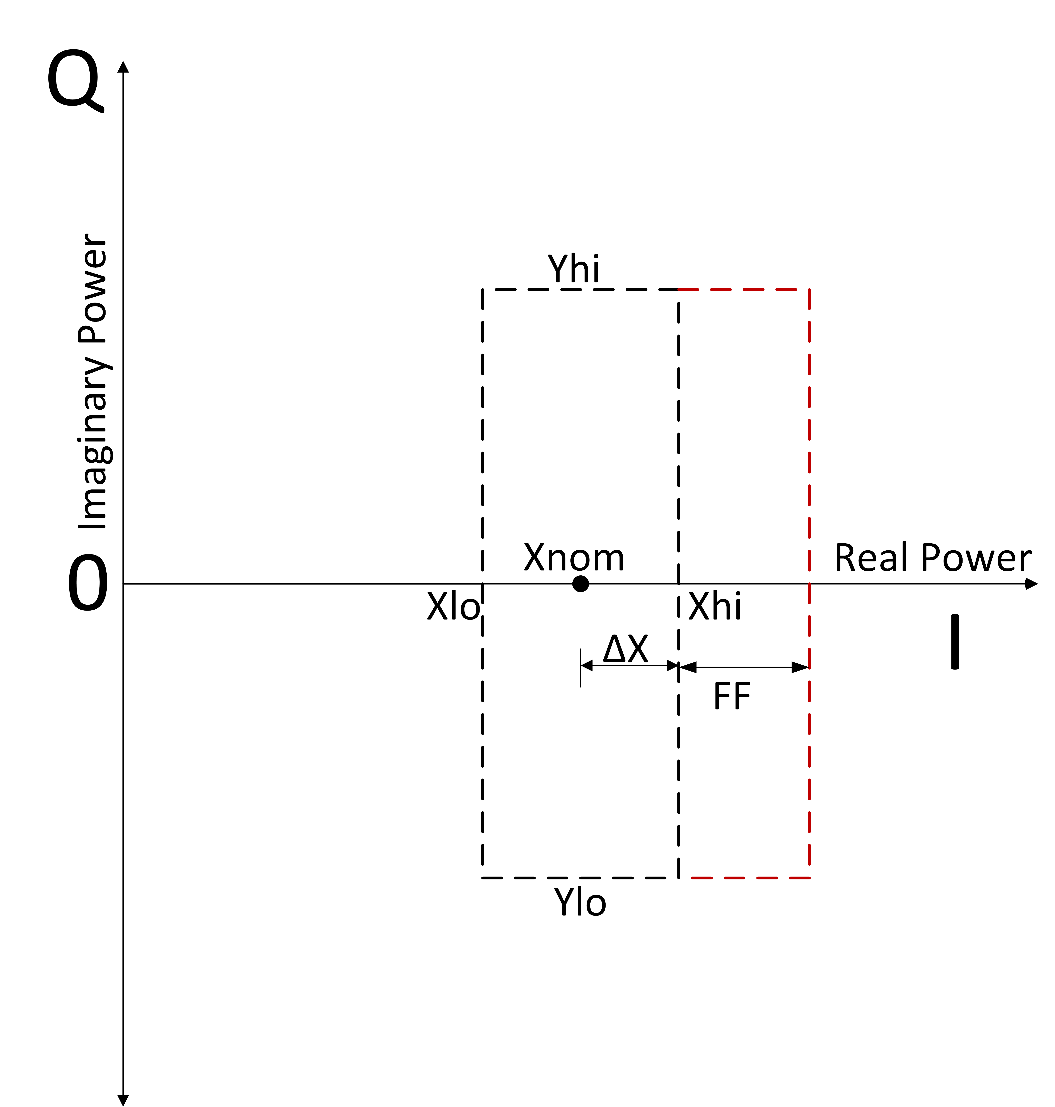
Adding Gated Feedforward for Beam Loading
FF_I
+
+
FF_Q

Slide 21
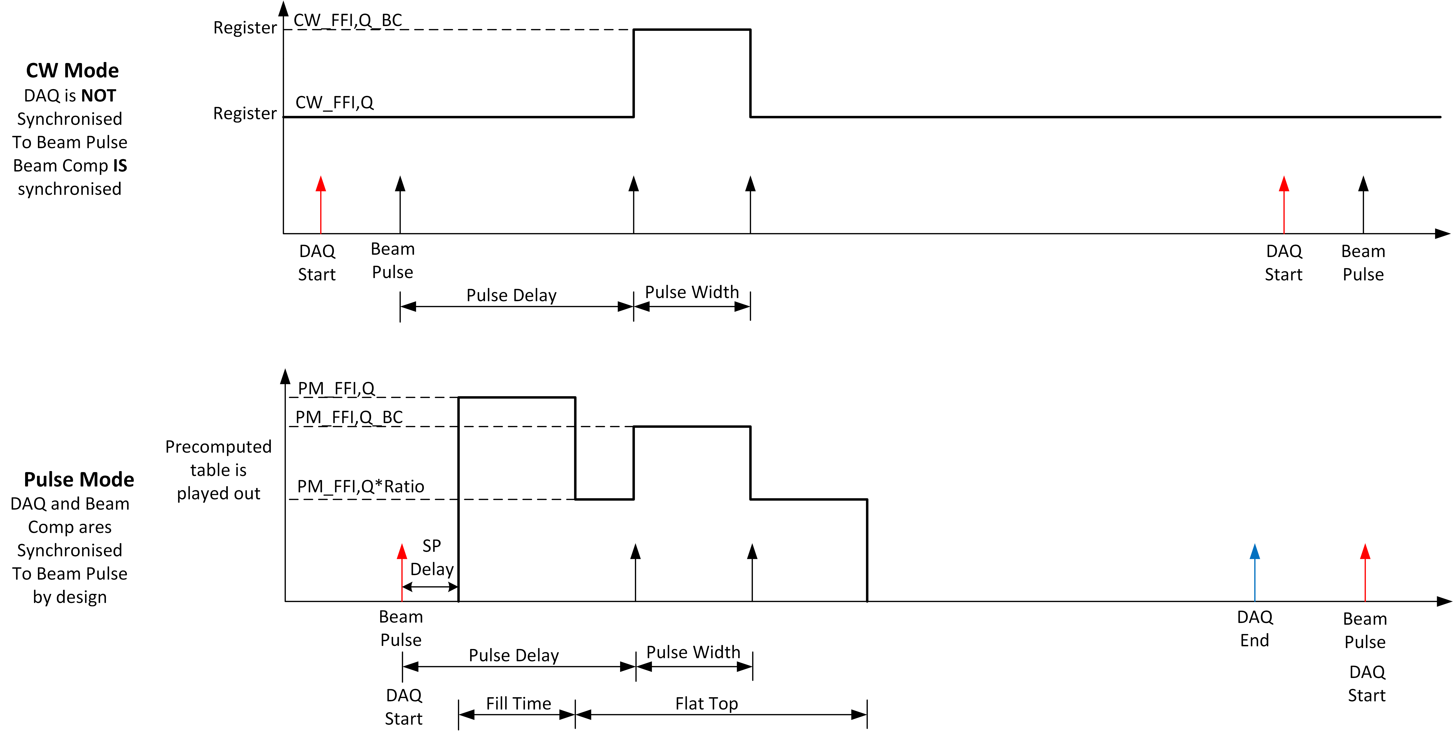
Adding Gated Feedforward for Beam Loading

Slide 22
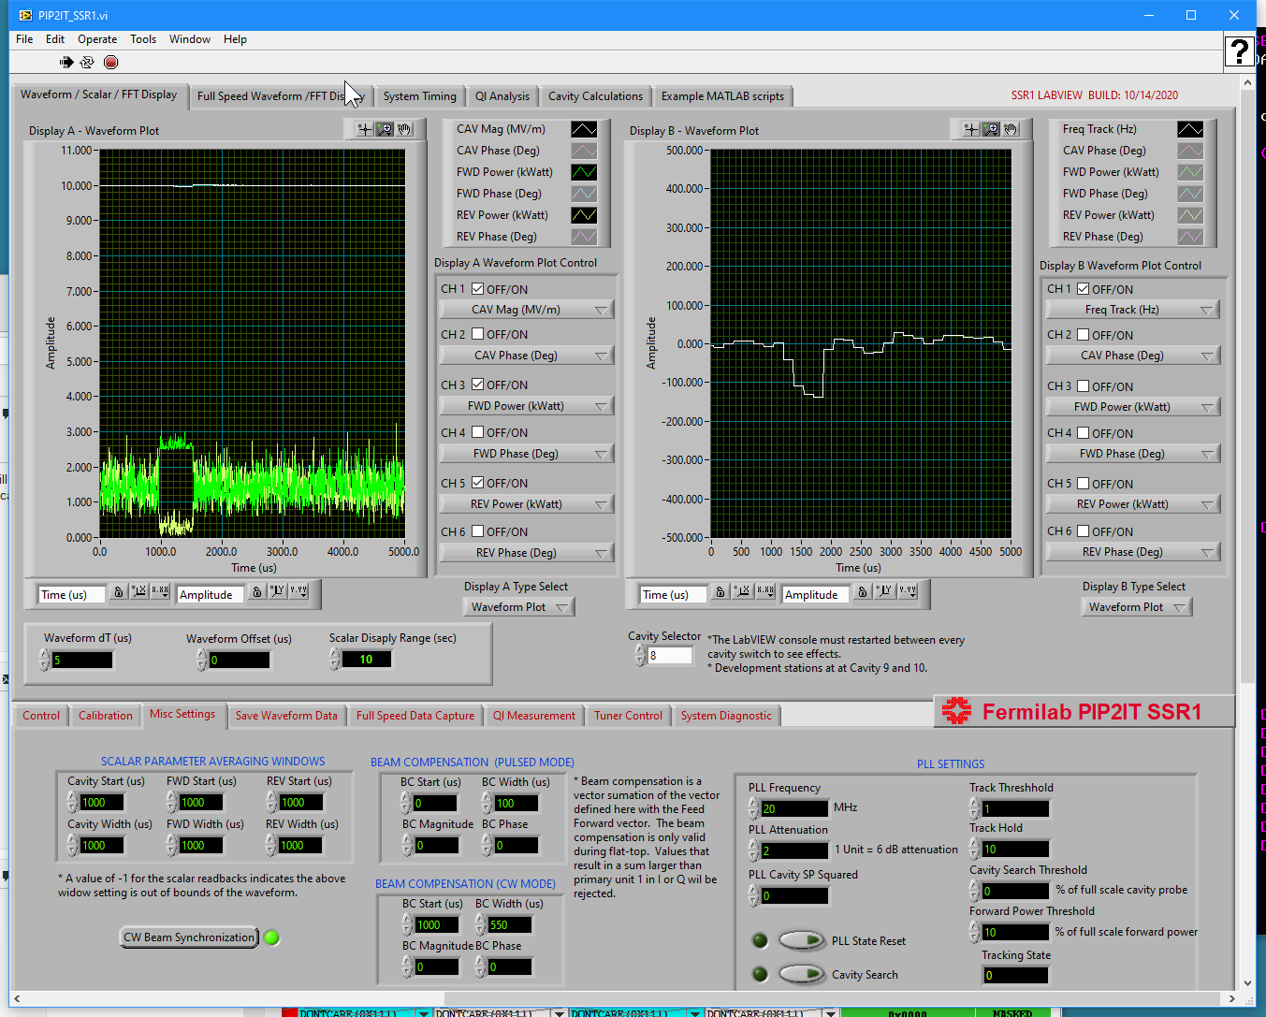
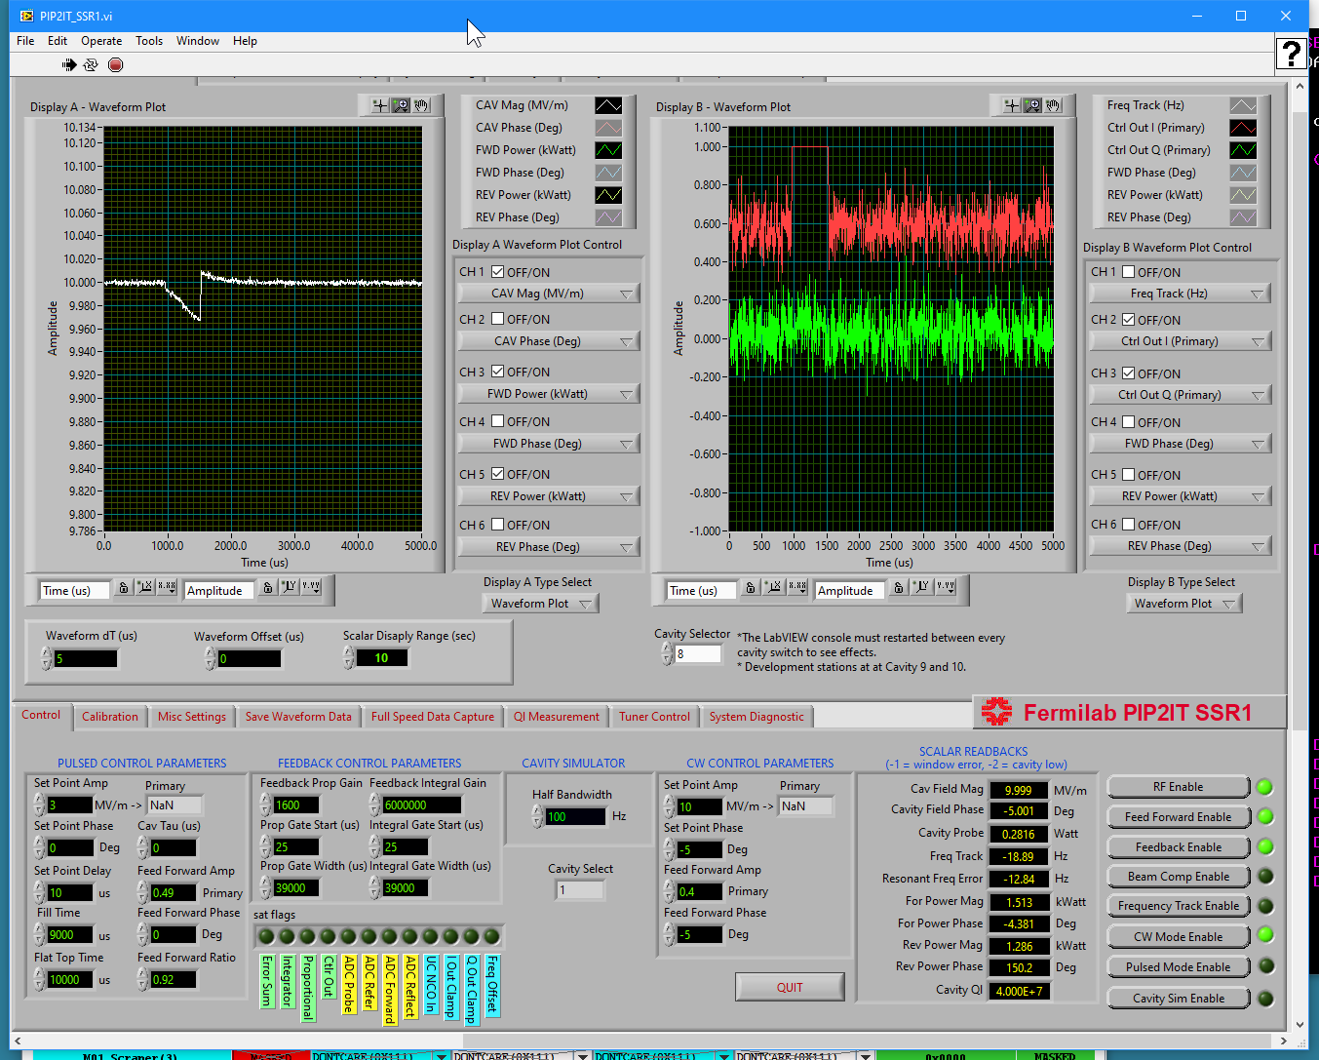
Beam Loading in SSR1 Cavity

Slide 23
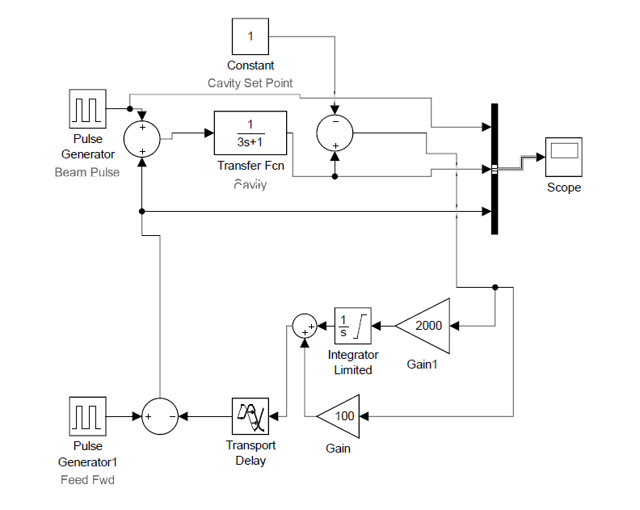
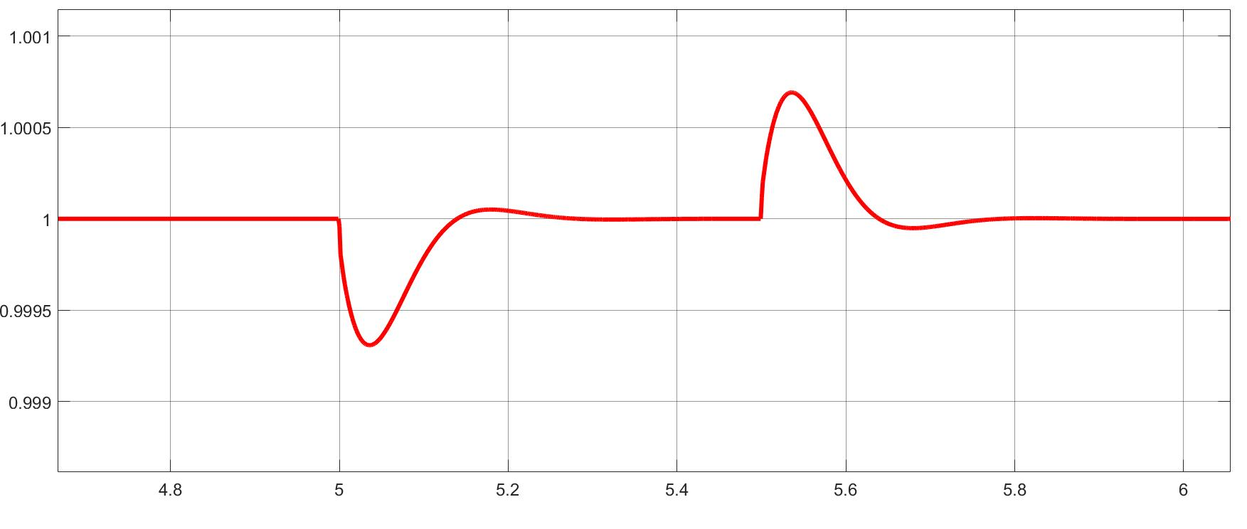
Beam Loading in SSR1 Cavity

Slide 24
Steps Towards Performance I$mprovement$
Add feedforward(FF) beam loading compensation(BLC)
Gating of FF BLC with beam arrival trigger is required – PIP-II beam Duty cycle is only 1%
DAC drive limits need to be adjusted for each cavity type due to differing beam/no beam power ratios
Loop delays of ~ 3 μs can be improved with firmware changes
Amplifier non-linearity should be handled correctly as a variety of amplifier sizes and vendors are being used
LCLS-II and PIP-II linacs are using the same codebase – both projects will benefit from the improvements

Slide 25
$$Summary$$
The SEL Implementation for PIP-II was described
Stabilty Analysis was used to determine theoretical feedback gain limits
The beam loading for PIP-II cavities was compared with the output saturation limits currently being used
The need for gated feed forward beam loading compensation was demonstrated
Steps for improving performance were discussed

Slide 26
Thank You!

Slide 27
Backup Slides

Slide 28


Beam Loading Power Calculation

Slide 29






HWR Control Performance
Detuning
Histograms
Cavity 4
Cavity 5
PIP-II Specifications
Energy Stability(Linac) < 0.01%
Amplitude Regulation(individual cavity) < 0.06 rms %
Phase Regulation < 0.06 rms deg
Maximum detuning < 20 Hz
Cavity 6
Cavity 7
Cavity 8

Slide 30









SSR1 Cryomodule Testing
Microphonics Detuning
Piezo Transfer Function – C1
Cavity1
Cavity2
Cavity3
Cavity4
Cavity5
Cavity6
Cavity7
Cavity8

